Slide 1
SharePoint y los Cognitive Services de Azure La vacuna para el autismo de SharePoint: Azure Cognitive Services
Gustavo Velez
Notes:
This slide is mandatory. Please do not remove.

Slide 2
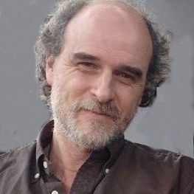
Gustavo Velez
MVP Office Servers and Services
Sogeti
http://www.gavd.net
gustavo@gavd.net

Slide 3
Notes:
This slide is mandatory. Please do not remove and try to use it during Q&A at the end of your session. Thank you!

Slide 4
WiFi Keys for Attendees
Connect to the wireless network MSFTGUEST
Click on Event Attendee Code and enter the access code: msevent47pu

Slide 5
Programa
Pequeña introducción a Azure y sus Cognitive Services
Demos, demos y mas demos
- Escuchar/hablar
- Ver
- Leer
- Encontrar
- Entender

Slide 6

Una palabra sobre Autismo
Según la Wikipedia, autismo se caracteriza por:
Impairments in social interaction
Impairments in communication
Restricted interests
Repetitive behavior
Modern Psychology believes autism should be accepted as a difference and not treated as a disorder

Slide 7
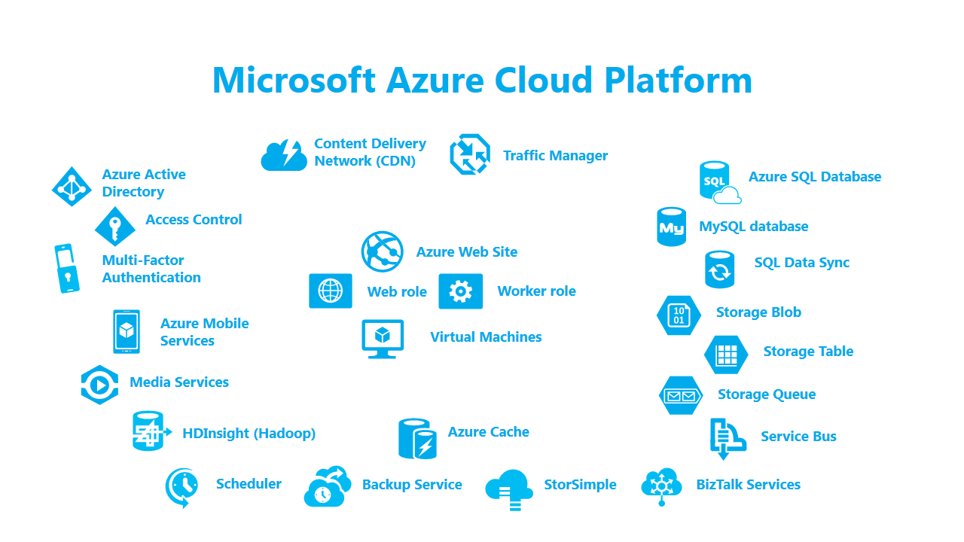
Y otra palabra sobre Azure

Slide 8
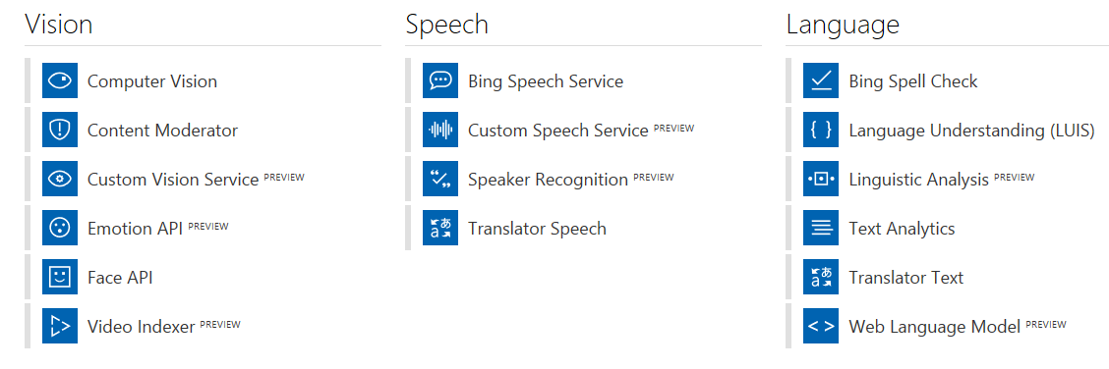
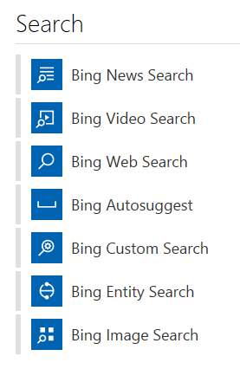
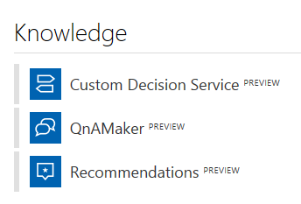
Que son los Cognitive Services de Azure

Slide 9

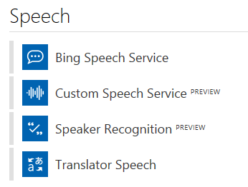

Haciendo que SharePoint hable y escuche
Speech to Text
Text to Speech

Slide 10
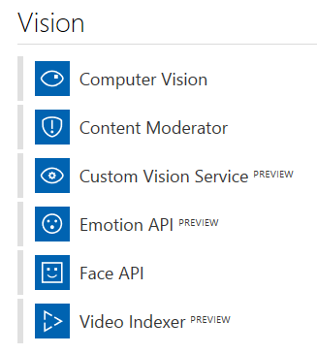
Cuando SharePoint puede ver
Image Analyze
Celebrity
Gender
Age

Slide 11
Cuando SharePoint puede leer
OCR Analyze
Handwriting Analyze
Text
Language

Slide 12
SharePoint también puede encontrar...
Bing Search
(Services Combination)

Slide 13
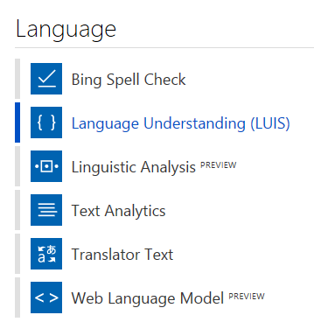
Y si SharePoint pudiera entender...
Bing Translation
(Services Combination)

Slide 14
Una nota sobre el futuro
SharePoint Conference North America (21-23 mayo 2018):
SharePoint Spaces - Three-dimensional SharePoint site (BabylonJS) with mixed reality headset
Scan button in OneDrive Mobile App to capture images and upload to Office 365 automatically
**Where photos exist in SharePoint, recognize objects and extract text from photos
**SharePoint will use cognitive services to analyze text for sentiment, key phrases, translation and moderation
See announcements:
“Enrich your SharePoint Content with Intelligence and Automation” (https://techcommunity.microsoft.com/t5/SharePoint-Blog/Enrich-your-SharePoint-Content-with-Intelligence-and-Automation/ba-p/194174)
“SharePoint innovations transform content collaboration with mixed reality and AI” (https://www.microsoft.com/en-us/microsoft-365/blog/2018/05/21/sharepoint-innovations-transform-content-collaboration-with-mixed-reality-and-ai/)

Slide 15
Conclusiones
Azure y SharePoint... Una gran combinación
Azure Cognitive Services: fáciles de usar y programar, baratos
Microsoft ya tiene todos los ladrillos listos, ahora esta comenzando a ensamblar la casa...

Slide 16
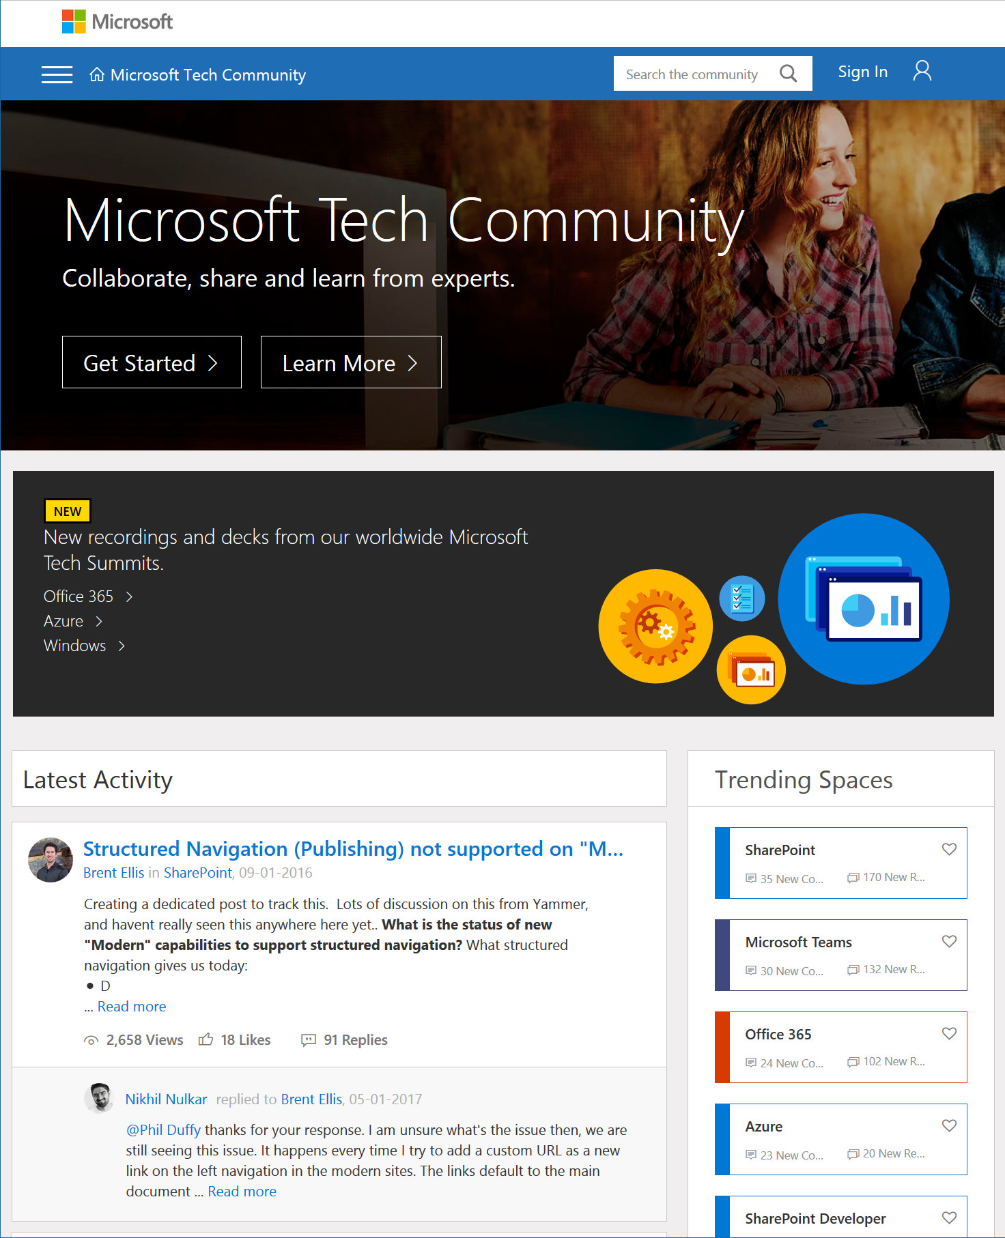
Microsoft Tech Community
techcommunity.microsoft.com
One Microsoft community for IT Pros and tech enthusiasts to learn from experts on Microsoft products
Trusted resource for news, best practices and answers from Microsoft product teams and MVPs
Join today! It’s free – sign in with your Microsoft Account.

Slide 17
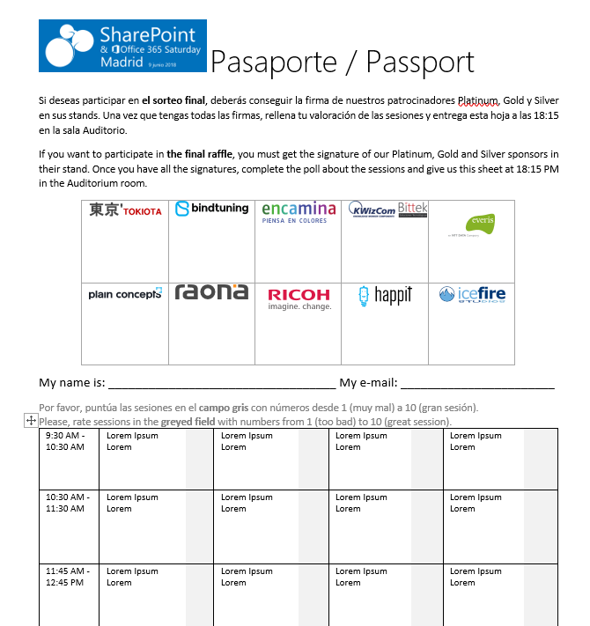








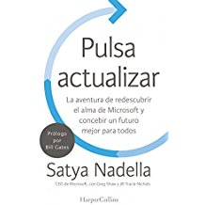


Raffle
Please, fill your SP & Office 365 Saturday Madrid passport if you want to participate.
You can win one of these gifts:
Please, fill your SP & Office 365 Saturday Madrid passport if you want to participate.
You can win one of these gifts:
Odor
Odor@winterfell.com
10
9
2x
2x
8

Slide 18
Notes:
This slide is mandatory. Please do not remove and try to use it during Q&A at the end of your session. Thank you!

Slide 19
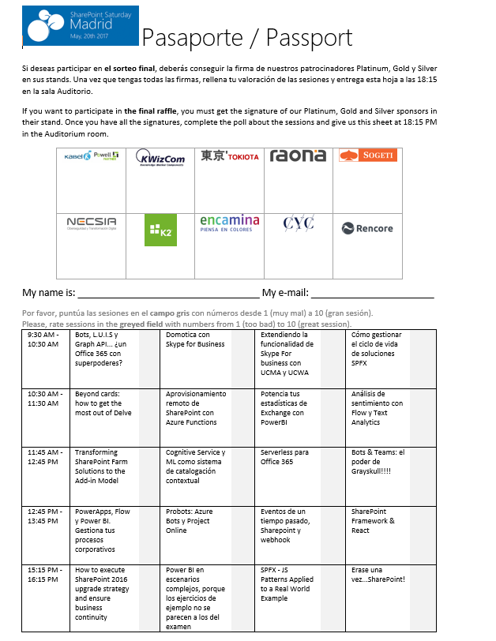
Raffle
Please, fill your SP & Office 365 Saturday Madrid passport if you want to participate.
You can win one of these gifts:
Odor
Odor@winterfell.com
10
9
8

